Slide 1
IBM Capstone Project- Battle of Neighbourhoods-
Shivam449

Slide 2
Business Problem: Real estate in london is in going through many changes due various factors such as brexit etc.
Solution:
n such sceanrio, roperty buyers need to understand the the market through clustering and associating neighbourhoods with price ranges to help them make correct decision.

Slide 3
Data and Methodology
Mehodology:
Collect Inspection Data;
Explore and Understand Data;
Data preparation and preprocessing;
Modeling

Slide 4
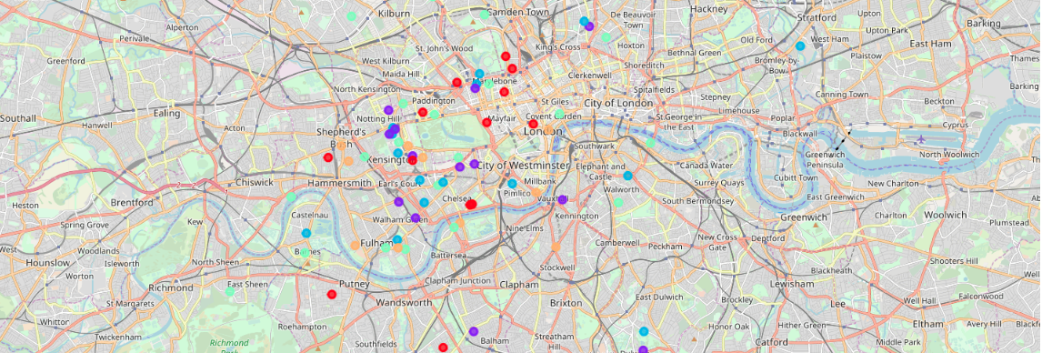
K-Means clustering

Slide 5
Outcome:
Real estates recommendations for the home buyers based on various preferences such as areas with parks and water fronts for families or proximity to pubs, restaurants for young couples.

